Slide 1
THE GRANT GROUP LLC.
MARCH 17, 2021
Sepsis Prevention & Early Recognition
JANET A. PHOENIX, MD, MPH, MS
MICHELLE GEORGE, MPH

Slide 2
Outline
Sepsis Training Day # 1
Poll
Definition of Sepsis
What is it?
Who is at risk?
How Sepsis Affects the Body
Small Group Exercise
Epidemiology
Data on Prevalence of Sepsis in US
Data on Prevalence of Sepsis in Maryland
Local Data on Montgomery County
Early Recognition/Treatment of Sepsis in Long Term Care Settings
Signs and Symptoms

Slide 3
Sepsis Training Day 1
MARCH , 2021
Definition of Sepsis

Slide 4
What is sepsis?
“Life-threatening organ dysfunction caused by a dysregulated host response to infection.”
Sepsis is the body’s extreme reaction to an infection. It happens when a current infection triggers a chain reaction throughout your body that can have deadly results (cytokine storm)
Sepsis starts with infection.
If this infection is not recognized and treated promptly it can lead to sepsis
Sepsis is a medical emergency and is life threatening
Without timely treatment sepsis can lead to organ failure and death
This is often referred to as Septic Shock.
Notes:
Source (APA 7th ed): It's Time To Talk About Sepsis. Cdc.gov/sepsis. (2021). Retrieved 16 February 2021, from https://www.cdc.gov/sepsis/pdfs/Consumer_brochure_its-time-to-talk-about-sepsis-P.pdf.

Slide 5
Most Common infections leading to Sepsis
Pneumonia
Urinary Tract Infections
Gastrointestinal Infections
Skin and Soft Tissue Infections
Notes:
Centers for Disease Control and Prevention. (2021). Epidemiology of Sepsis. Morbidity and Mortality Weekly Report, 65(33); 864-869.

Slide 6
Most Common Organisms Causing Sepsis
Staphyloccus
E. Coli
Streptococcus
Notes:
Centers for Disease Control and Prevention. (2021). Epidemiology of Sepsis. Morbidity and Mortality Weekly Report, 65(33); 864-869.

Slide 7
Sepsis Training Day 1
MARCH 17, 2021
Who is at risk?

Slide 8
Who is at Risk
Anyone can get an infection, and any infection can lead to sepsis. However, there are some people more at risk than others.
Chronic medical conditions like HIV, diabetes, lung disease, kidney disease
Older Adults aged 65+
Immunosenescence
People with cognitive impairment
People with weakened immune systems
People with cancer
Sepsis survivors
Hospitalized patients
Notes:
1. Angele, M. K., Pratschke, S., Hubbard, W. J., & Chaudry, I. H. (2014). Gender differences in sepsis: cardiovascular and immunological aspects. Virulence, 5(1), 12–19. https://doi.org/10.4161/viru.26982
2. Frydrych, L. M., Fattahi, F., He, K., Ward, P. A., & Delano, M. J. (2017). Diabetes and Sepsis: Risk, Recurrence, and Ruination. Frontiers in endocrinology, 8, 271. https://doi.org/10.3389/fendo.2017.00271

Slide 9
Cancer as a Sepsis Risk Factor
Cancer seemed to be a predictive factor for death in sepsis survivors.
Cancer seemed to function independently of other sepsis related factors
Notes:
Courtright, K. R., Jordan, L., Murtaugh, C. M., Barrón, Y., Deb, P., Moore, S., . . . Mikkelsen, M. E. (2020). Risk factors for long-term mortality and patterns of end-of-life care among medicare sepsis survivors discharged to home health care. JAMA Network Open, 3(2), 1-16. doi:10.1001/jamanetworkopen.2020.0038

Slide 10
DIABETES AND SEPSIS MORTALITY
Those with Type II diabetes had the highest sepsis infection rates.
Diabetes causes a functional immune deficiency that directly reduces immune cell function. As a result, patients display diminished bactericidal clearance, increased complications.
Long-term sepsis mortality is at 60–80%.
Notes:
Frydrych, L. M., Fattahi, F., He, K., Ward, P. A., & Delano, M. J. (2017). Diabetes and Sepsis: Risk, Recurrence, and Ruination. Frontiers in endocrinology, 8, 271. https://doi.org/10.3389/fendo.2017.00271

Slide 11
Why is Chronic Disease a Risk Factor for Sepsis?
Chronic disease causes a functional immune deficiency
This reduces the function of immune cells
This diminishes the ability of the body to clear bacteria or other infectious agents from the body
This increases complications and increases the risk of mortality
Notes:
Frydrych, L. M., Fattahi, F., He, K., Ward, P. A., & Delano, M. J. (2017). Diabetes and Sepsis: Risk, Recurrence, and Ruination. Frontiers in endocrinology, 8, 271. https://doi.org/10.3389/fendo.2017.00271

Slide 12
Older people experience Immunosenescence
Immunosenescence
Refers to the age associated decline of the immune system that may contribute to increased occurrence and severity of infectious diseases in the elderly population
Notes:
Solana, R., & Pawelec, G. (2004). Immunosenescence. The Neuroendocrine Immune Network in Ageing, 4, 9-21. doi:10.1016/s1567-7443(04)80003-6

Slide 13
Immunosenescence as a Risk Factor for Sepsis
Reduction of function of cell-mediated immunity (the body’s response to intracellular pathogens) and
Decline in humoral immunity (involving antibodies which – the body’s response to extracellular pathogens) and
Increases not only the risk for developing sepsis but also leads to more severe presentation of infection and a higher risk of death (Martín, Pérez, & Aldecoa, 2017)
Notes:
Martín, S., Pérez, A., & Aldecoa, C. (2017). Sepsis and Immunosenescence in the Elderly Patient: A Review. Frontiers in medicine, 4, 20. https://doi.org/10.3389/fmed.2017.00020
Solana, R., & Pawelec, G. (2004). Immunosenescence. The Neuroendocrine Immune Network in Ageing, 4, 9-21. doi:10.1016/s1567-7443(04)80003-6

Slide 14
Being a survivor of Sepsis is a Risk Factor for Sepsis
Physical and psychological effects on sepsis survivors can leave a devastating impact on quality of life after sepsis;
Effects can include cognitive and functional impairments; increased risk of hospital readmission; increased risk of mortality
More than 50% of survivors of sepsis experience these effects
Sepsis survivors have residual immunosuppression in sepsis survivors
This contributes to risk of reinfection, not only of sepsis, but of other recurrent infections
Notes:
1) Courtright, K. R., Jordan, L., Murtaugh, C. M., Barrón, Y., Deb, P., Moore, S., . . . Mikkelsen, M. E. (2020). Risk factors for long-term mortality and patterns of end-of-life care among medicare sepsis survivors discharged to home health care. JAMA Network Open, 3(2). doi:10.1001/jamanetworkopen.2020.0038
2) Sepsis Alliance. (2021, January 21). Post-sepsis syndrome. Retrieved February 21, 2021, from https://www.sepsis.org/sepsis-basics/post-sepsis-syndrome/
3) Shankar-Hari, M., & Rubenfeld, G. D. (2016). Understanding Long-Term Outcomes Following Sepsis: Implications and Challenges. Current infectious disease reports, 18(11), 37. https://doi.org/10.1007/s11908-016-0544-7
4) Wang, T., Derhovanessian, A., De Cruz, S., Belperio, J. A., Deng, J. C., & Hoo, G. S. (2014). Subsequent infections in survivors of sepsis: epidemiology and outcomes. Journal of intensive care medicine, 29(2), 87–95. https://doi.org/10.1177/0885066612467162

Slide 15
What Questions Can Guide Us in Sepsis Prevention at the time of Admission
Has the patient had sepsis previously?
Does the patient have an infection?
Does the patient have cancer?

Slide 16
Sepsis Training Day 1
MARCH 17, 2021
How does Sepsis affect the body?

Slide 17
How does the Immune System react during Sepsis?
The immune system mobilizes infection fighting cells.
Some are local in the tissue that is injured or at the site of infection.
Some travel there through the blood
Those that travel leave the blood vessels to get to the infection site.
Notes:
Murphy, K. and Weaver, C. eds. (2017). Janeway’s Immunobiology. 9th Edition. New York and London: .Garland Science; Taylor and French Group.

Slide 18
How does the Immune System react during Sepsis?
There can be local tissue damage that occurs as the infection is being fought.
Blood vessels typically dilate and can later form small clots.
These clots are the body’s attempt to wall of the infection and keep it from spreading.
Notes:
Murphy, K. and Weaver, C. eds. (2017). Janeway’s Immunobiology. 9th Edition. New York and London: .Garland Science; Taylor and French Group.

Slide 19
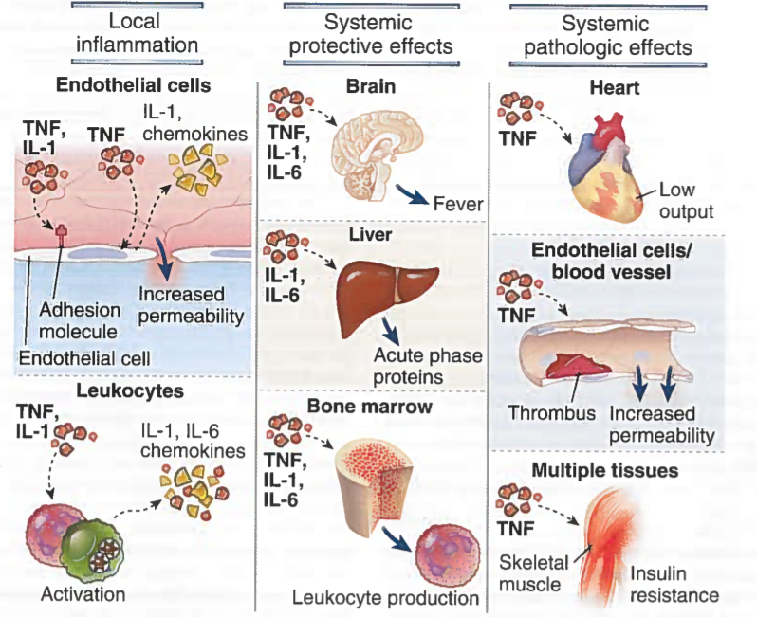
Notes:
Murphy, K. and Weaver, C. eds. (2017). Janeway’s Immunobiology. 9th Edition. New York and London: .Garland Science; Taylor and French Group.

Slide 20
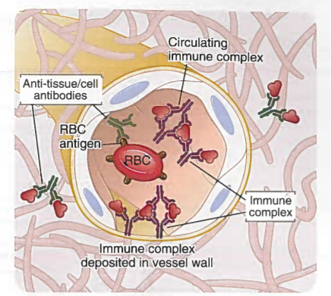
Notes:
Murphy, K. and Weaver, C. eds. (2017). Janeway’s Immunobiology. 9th Edition. New York and London: .Garland Science; Taylor and French Group.

Slide 21
What is Septic Shock?
“Septic shock is a subset of sepsis when circulatory and cellular dysfunction is associated with a higher risk of mortality.”
When these small clots form in organs like the kidney or lungs, then these organs don’t get the circulation they need.
The slowing of blood flow to the organs is a hallmark sign of sepsis.
This can lead to organ failure.
Notes:
Murphy, K. and Weaver, C. eds. (2017). Janeway’s Immunobiology. 9th Edition. New York and London: .Garland Science; Taylor and French Group.
Centers for Disease Control and Prevention. What is Sepsis? www.cdc.gov/what-is-sepsis.html

Slide 22
COVID-19 CAN CAUSE SEPSIS
“Septic shock is a subset of sepsis when circulatory and cellular dysfunction is associated with a higher risk of mortality.”
Although pneumonia is the most common organ system affected by Covid-19, almost every organ system can be affected.
“Signs of multi organ injury typical of sepsis occur in approximately 2 to 5% of those with Covid-19
If sepsis results from Covid-19 infection it typically occurs 8 to 10 days after onset of symptoms
Early recognition of sepsis symptoms is important in recognizing this in people infected with Covid-19
Notes:
Global Sepsis Alliance. https://www.global-sepsis-alliance.org/covid19. Accessed March 11, 2021.

Slide 23
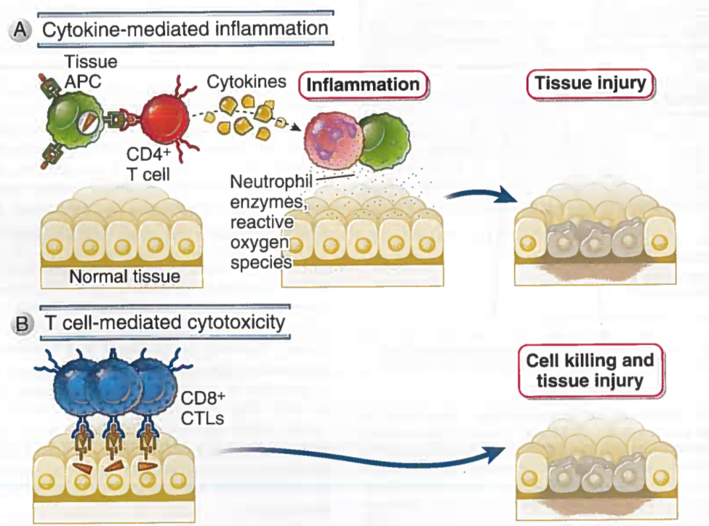
Notes:
Murphy, K. and Weaver, C. eds. (2017). Janeway’s Immunobiology. 9th Edition. New York and London: .Garland Science; Taylor and French Group.

Slide 24
Notes:
https://www.youtube.com/watch?v=BcE58U_Ugbo - Minnesota Hospital Association

Slide 25
Sepsis Training Day 1
MARCH 17, 2021
Restroom Break

Slide 26
Resident Assessed for Infection and Organ Function
Labs were Ordered with instructions to rush results
Lactate
Blood cultures
UA/UC,
Electrolytes
BUN
Creatinine
PT/INR

Slide 27
Sepsis Bundle Orders
Standing orders were present in the Electronic Health Record
30 mL/kg crystalloid bolus
230 pounds (104 kg) x 30 mL/kg = 3136mL for bolus (3 L of fluid)
Started on broad spectrum antibiotics
Vital signs at least every 15 minutes

Slide 28
Resident Reassessed
Vital signs following fluid bolus:
Blood pressure: 78/46 (Initial Value 84/52)
Pulse: 150 (Initial Value 145)
Temp: unchanged
Oxygen saturation: 88% on 2L
Respirations: 20 – shallow (initial value 22)
Mental State: Remains confused: answers questions inappropriately

Slide 29
Laboratory Values
Labs are in
Lactate: 4.2
WBC: 2.0
Hemoglobin: 9.2
Creatinine: 2.4
INR: 2.1

Slide 30
What would you recommend?
What steps should be taken to respond to this new information about Dorothy’s condition?
What do the results of the labs and the assessment indicate?
What would you recommend?

Slide 31
Sepsis Training Day 1
MARCH 17, 2021
Epidemiology of Sepsis

Slide 32
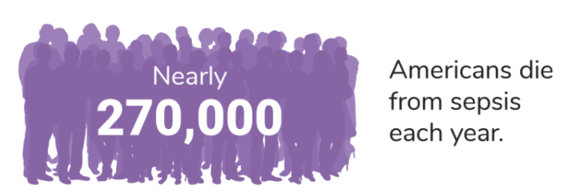
Epidemiology of Sepsis
Every year, at least 1.7 million adults in the USA develop sepsis
Nearly 270,000 Americans die as a result of sepsis
1 in 3 patients who dies in hospital has sepsis
Louisiana has the highest rate of sepsis deaths followed by New Jersey and Alabama
Sepsis is present in 30% to 50% of hospitalizations that culminate in death
1/3 of sepsis survivors are re-hospitalized within 3 months of initial sepsis
Notes:
1) Rhee, C., Jones, T. M., Hamad, Y., Pande, A., Varon, J., O’Brien, C., . . . Klompas, M. (2019). Prevalence, underlying causes, and PREVENTABILITY of Sepsis-Associated mortality in US acute care hospitals. JAMA Network Open, 2(2), 1-14. doi:10.1001/jamanetworkopen.2018.7571
2) Centers for Disease Control and Prevention. (2021, February 16). Stats of the states - septicemia mortality. Retrieved February 21, 2021, from https://www.cdc.gov/nchs/pressroom/sosmap/septicemia_mortality/septicemia.htm
3) Sepsis Alliance. (2021, February 21). Posters and infographics. Retrieved February 21, 2021, from https://www.sepsis.org/education/resources/posters-and-infographics/
NIH Sepsis Infographic. Centers for Disease Control & Prevention. National Center for Emerging and Zoontic Infectious Diseases. Division of Health Quality Promotion, accessed September 2019

Slide 33
Epidemiology of Sepsis in Maryland
In Maryland, sepsis is among the top 10 most common potentially preventable complications across Maryland hospitals, and one of the leading causes of mortality and readmission
Sepsis claims about 1,100 lives in Maryland each year
9th leading cause of death in Maryland
Notes:
Source: 1) Maryland Patient Safety Center. (2015). Improving Sepsis Survival. Retrieved February 21, 2021, from https://www.marylandpatientsafety.org/Sepsis.aspx#:~:text=On%20average%2C%20about%2030%20percent,Maryland%20each%20year%2C%20she%20said.
2) Centers for Disease Control and Prevention. (2021, February 16). Stats of the states - septicemia mortality. Retrieved February 21, 2021, from https://www.cdc.gov/nchs/pressroom/sosmap/septicemia_mortality/septicemia.htm

Slide 34
Epidemiology of Sepsis in Maryland
From April 2019 through March 2020, 9% of initial total hospital admissions in the state of Maryland were for Septicemia.
From April 2019 through March 2020, 11% of hospital readmissions after an index hospitalization in Maryland were for Septicemia.
Septicemia was among the top 10 diagnostic categories listed as cause of hospital admissions during this time period.
Notes:
1) Maryland Patient Safety Center. (2015). Improving Sepsis Survival. Retrieved February 21, 2021, from https://www.marylandpatientsafety.org/Sepsis.aspx#:~:text=On%20average%2C%20about%2030%20percent,Maryland%20each%20year%2C%20she%20said.
2) Centers for Disease Control and Prevention. (2021, February 16). Stats of the states - septicemia mortality. Retrieved February 21, 2021, from https://www.cdc.gov/nchs/pressroom/sosmap/septicemia_mortality/septicemia.htm

Slide 35
Sepsis in Montgomery County
From April 2019 through March 2020, in selected Montgomery County Zip Codes, 12.3% of initial total hospital admissions were for Septicemia.
From April 2019 through March 2020, in selected Montgomery County Zip codes, 16.4% of hospital readmissions after an index hospitalization were for Septicemia.
Notes:
1) Maryland Patient Safety Center. (2015). Improving Sepsis Survival. Retrieved February 21, 2021, from https://www.marylandpatientsafety.org/Sepsis.aspx#:~:text=On%20average%2C%20about%2030%20percent,Maryland%20each%20year%2C%20she%20said.
2) Centers for Disease Control and Prevention. (2021, February 16). Stats of the states - septicemia mortality. Retrieved February 21, 2021, from https://www.cdc.gov/nchs/pressroom/sosmap/septicemia_mortality/septicemia.htm

Slide 36
What happens to Patients following the initial Sepsis Occurrence?
60% are hospitalized again
1 in 6 die
Most common cause of rehospitalization is infection (either unresolved/recurrent infection or new infection)
Pneumonia most common site of infection in those hospitalized again
Notes:
Shankar-Hari, M., & Rubenfeld, G. D. (2016). Understanding long-term outcomes following sepsis: Implications and challenges. Current Infectious Disease Reports, 18(11), 1-9. doi:10.1007/s11908-016-0544-7

Slide 37
What are the Risk Factors for Rehospitalization?
Prolonged hospitalization
Age
Presence of an indwelling catheter
Notes:
Shankar-Hari, M., & Rubenfeld, G. D. (2016). Understanding long-term outcomes following sepsis: Implications and challenges. Current Infectious Disease Reports, 18(11), 1-9. doi:10.1007/s11908-016-0544-7

Slide 38
Notes:
https://www.cdc.gov/longtermcare/training.html

Slide 39
The Core Elements of Antibiotic Stewardship for Nursing Homes
https://www.cdc.gov/longtermcare/pdfs/core-elements-antibiotic-stewardship.pdf

Slide 40
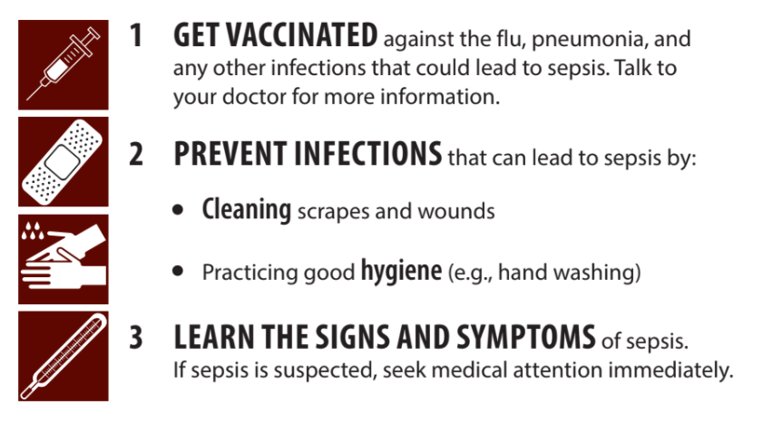
Preventing Sepsis
Notes:
Centers for Disease Control and Prevention Sepsis Alliance® and the Rory Staunton Foundation for Sepsis Prevention Fact Sheet

Slide 41
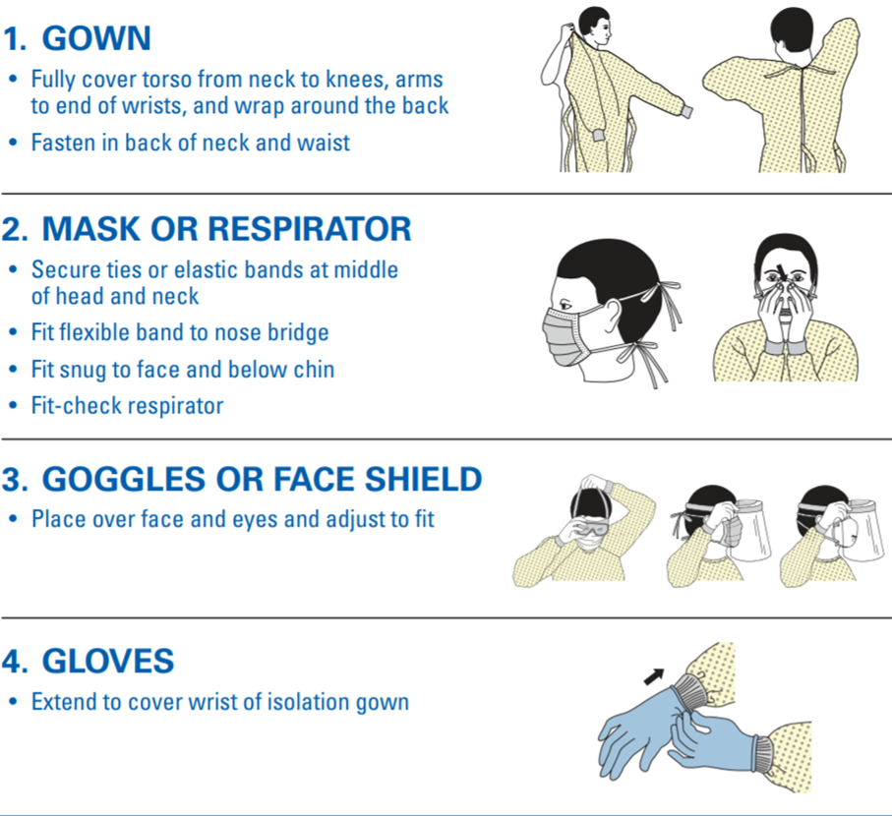
Personal Protective Equipment
Notes:
Centers for Disease Control and Prevention, National Institute for Occupational Safety and Health: Sequence for Putting On Personal Protective Equipment: https://www.cdc.gov/niosh/npptl/pdfs/PPE-Sequence-508.pdf

Slide 42
Sepsis Prevention (World Health Organization)
Notes:
https://www.youtube.com/watch?v=GKRQm0i5JdI

Slide 43
Sepsis Training Day 1
MARCH , 2021
Early Recognition of Sepsis in Long-Term Care Settings

Slide 44
Sepsis Training Day 1
MARCH , 2021
Signs and Symptoms

Slide 45
Recognition of Sepsis
Altered mental status
Confusion
Falls
Malaise
Tachycardia (heart rate > 90 bpm)
Arterial hypotension (SBP < 90 mmHg, MAP < 70 mmHg, or an SBP decrease > 40 mmHg)
Cough, dyspnea, tachypnea (respiratory rate > 22 breaths/minute)
Notes:
Reyes, B. J., Chang, J., Vaynberg, L., Diaz, S., & Ouslander, J. G. (2018). Early identification and management of sepsis in nursing facilities: Challenges and opportunities. Journal of the American Medical Directors Association, 19(6), 465-471. doi:10.1016/j.jamda.2018.04.004

Slide 46
Factors Complicating Recognition of Sepsis
Mental Status Changes – Many residents have cognitive deficits making it difficult to recognize a cognitive decline
Increased respiratory rate – Conditions such as asthma or COPD are common and can cause increased respiratory rate
Hypotension – Medications given for hypertension, heart failure and psychological disorders can all lower blood pressure.
Tachycardia – Beta blockers or cardiac conduction disorders can cause tachycardia
Fever – Some residents don’t exhibit fever when they are infected. Older people may have lower baselines temperatures than younger people.
Notes:
Reyes, B. J., Chang, J., Vaynberg, L., Diaz, S., & Ouslander, J. G. (2018). Early identification and management of sepsis in nursing facilities: Challenges and opportunities. Journal of the American Medical Directors Association, 19(6), 465-471. doi:10.1016/j.jamda.2018.04.004

Slide 47
Without prompt treatment sepsis can lead to
Notes:
National Institutes of Health Sepsis Infographic. Centers for Disease Control & Prevention. National Center for Emerging and Zoontic Infectious Diseases. Division of Health Quality Promotion, accessed September 2019

Slide 48
Change in Condition Identified
Using the “STOP and WATCH”
early warning tools or other alert
Reyes, et. al, 2018
Initiate Change in Condition
Evaluation using SBAR Communication Tool
Notify Clinician
INTERACT Care Path Criteria for Notifying
Clinician Met
Infection Suspected or Confirmed?*
Initiate Treatment
Possible Sepsis?
Consider Transfer to Acute Care
Manage in Facility if:
Resident/Patient has a “do not hospitalize order”, is on comfort or palliative care, or hospice; or
Resident/Patient or family wants treatment in the facility, understands the risks, and facility can provide guideline recommended sepsis care
Notes:
Reyes, B. J., Chang, J., Vaynberg, L., Diaz, S., & Ouslander, J. G. (2018). Early identification and management of sepsis in nursing facilities: Challenges and opportunities. Journal of the American Medical Directors Association, 19(6), 465-471. doi:10.1016/j.jamda.2018.04.004

Slide 49
STOP and WATCH
STOP and WATCH early warning tool
Seems different than usual
Talks or communicates less
Overall needs more help
Pain – new or worsening; Participated less in activities
Ate less
No bowl movement in 3 days; or diarrhea
Drank less
Weight change
Agitated or nervous more than usual
Tired, weak, confused, drowsy
Change in skin color or condition
Help with walking, transferring, toileting more than usual
Notes:
INTERACT. INTERACT. https://pathway-interact.com/wp-content/uploads/2017/11/INTERACT-Guidance-on-Possible-Sepsis-November-8-2017.pdf
Stop and Watch Early Warning Tool 2011 Florida Atlantic University,

Slide 50
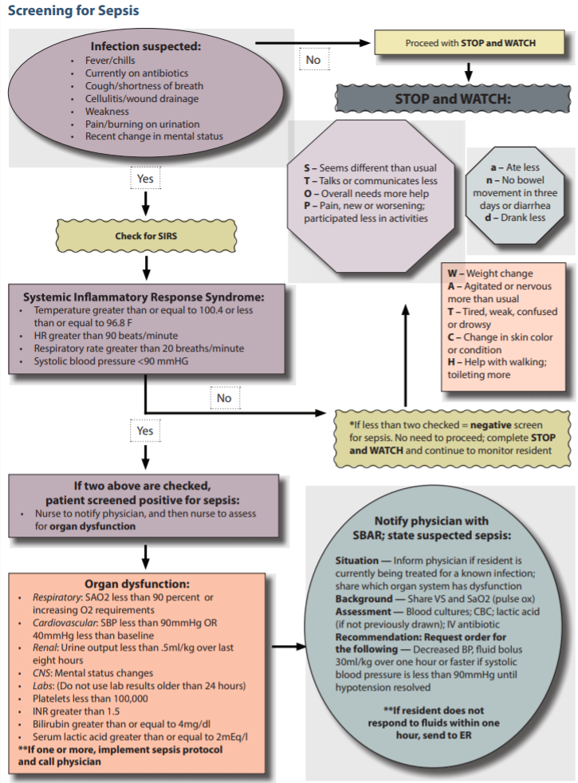
Notes:
Health Insight, the Medicare Quality Innovation Network Quality Improvement Organization for Nevada, New Mexico, Oregon and Utah. Materials were created under a contract with CMS but do not necessarily reflect the views of CMS. Source: https://healthinsight.org/tools-and-resources/send/367-sepsis/1386-%20sepsis-screening-flowchart (Accessed March 3, 2021).

Slide 51
Sepsis Recognition Flow Chart
Infection suspected
Fever/chills
Currently on abx
Cough/SOB
Cellulitis/wound drainage
Weakness
Recent change in mental status
No
Proceed with STOP and WATCH
STOP and WATCH:
S – seems different than usual
T- Talks or communicates less
O – Overall needs more help
P – Pain, new or worsening participated in less activities
A- Ate less
N – No bowel movement in 3 days or diarrhea
D – Drank less
YES
W – Weight change
A – Agitated or nervous more than usual
T – Tired, weak, confused or drowsy
C – Change in Skin color or condition
H – Help with walking; toileting more
Check for SIRS
*If less than 2 checked = negative screen for sepsis. No need to proceed, complete STOP and WATCH, continue monitoring Resident.
Systemic Inflammatory Response Syndrome:
Temperature ≥ 100.4 or ≤ 96.8 F
HR > 90 bpm
Respiratory Rate > 20 breaths/minute
Systolic BP < 90 mmHG
NO
YES
If two above are checked, pt. screened positive for sepsis:
Nurse notify physician, and then nurse to assess for organ dysfunction
Notes:
Health Insight, the Medicare Quality Innovation Network Quality Improvement Organization for Nevada, New Mexico, Oregon and Utah. Materials were created under a contract with CMS but do not necessarily reflect the views of CMS. Source: https://healthinsight.org/tools-and-resources/send/367-sepsis/1386-%20sepsis-screening-flowchart (Accessed March , 2021).

Slide 52
Sepsis Recognition Flow Chart Continued
Systemic Inflammatory Response Syndrome:
Temperature ≥ 100.4 or ≤ 96.8 F
HR > 90 bpm
Respiratory Rate > 20 breaths/minute
Systolic BP < 90 mmHG
Notify physician with SBAR; state suspected sepsis
Situation: Inform physician if resident is currently being treated for a known infection; share which organ system had dysfunction
Background: Share VS and SaO2 (pulse ox)
Assessment: Blood cultures; CBC; lactic acid (If not previously drawn); IV antibiotic
Recommendation: Request order for the following
Decreased BP
Fluid bolus 30 ml/kg over one hour or faster if systolic BP < 90 mmHG until hypotension resolved
YES
If two above are checked, pt. screened positive for sepsis:
Nurse notify physician, and then nurse to assess for organ dysfunction
Organ Dysfunction:
Respiratory: SA02 < 90 % or increasing O2 requirements
Cardiovascular: SBP < 90 mmHG or 40 mmHg less than baseline
Renal: Urine output < 0.5 ml/kg over last 8 hours
CNS: Mental status changes
Labs: (Do not use lab results older than 24 hours)
Platelets < 100,000
INR > 1.5
Bilirubin ≥ 4 mg/dl
Serum lactic acid ≥ 2mEq/l
*If one or more, implement sepsis protocol and call physician
Notes:
Health Insight, the Medicare Quality Innovation Network Quality Improvement Organization for Nevada, New Mexico, Oregon and Utah. Materials were created under a contract with CMS but do not necessarily reflect the views of CMS. Source: https://healthinsight.org/tools-and-resources/send/367-sepsis/1386-%20sepsis-screening-flowchart (Accessed March , 2021).

Slide 53
Sepsis Recognition Flow Chart Continued
Systemic Inflammatory Response Syndrome:
Temperature ≥ 100.4 or ≤ 96.8 F
HR > 90 bpm
Respiratory Rate > 20 breaths/minute
Systolic BP < 90 mmHG
Notify physician with SBAR; state suspected sepsis
Situation: Inform physician if resident is currently being treated for a known infection; share which organ system had dysfunction
Background: Share VS and SaO2 (pulse ox)
Assessment: Blood cultures; CBC; lactic acid (If not previously drawn); IV antibiotic
Recommendation: Request order for the following
Decreased BP
Fluid bolus 30 ml/kg over one hour or faster if systolic BP < 90 mmHG until hypotension resolved
YES
If two above are checked, pt. screened positive for sepsis:
Nurse notify physician, and then nurse to assess for organ dysfunction
Organ Dysfunction:
Respiratory: SA02 < 90 % or increasing O2 requirements
Cardiovascular: SBP < 90 mmHG or 40 mmHg less than baseline
Renal: Urine output < 0.5 ml/kg over last 8 hours
CNS: Mental status changes
Labs: (Do not use lab results older than 24 hours)
Platelets < 100,000
INR > 1.5
Bilirubin ≥ 4 mg/dl
Serum lactic acid ≥ 2mEq/l
*If one or more, implement sepsis protocol and call physician
Notes:
Health Insight, the Medicare Quality Innovation Network Quality Improvement Organization for Nevada, New Mexico, Oregon and Utah. Materials were created under a contract with CMS but do not necessarily reflect the views of CMS. Source: https://healthinsight.org/tools-and-resources/send/367-sepsis/1386-%20sepsis-screening-flowchart (Accessed March , 2021).

Slide 54
Notes:
Nevada Severe Sepsis Screening Nevada Sepsis Coalition. (2018). Nevada Severe Sepsis Screening Tool. Retrieved from https://healthinsight.org/tools-and-resources/send/367-sepsis/1387-severe-sepsis-screening-tool-for-nursing-homes
, Nevada Sepsis Coalition

Slide 55
Altered mental status
Acute onset and alternating flow
Inattention or easily distractible
Disorganized thinking or illogical flow of ideas
Altered level of consciousness
Notes:
Inouye, S. et al (1990). Clarifying confusion: The Confusion Assessment Method. Annals of Internal Medicine, 113 (12), 941-948.

Slide 56
What Questions Can Guide Us In Sepsis Prevention At the Time of Admission?
Has the patient had sepsis previously?
Does the patient have an infection?
Does the patient have cancer?

Slide 57
Where does Sepsis start?
Residents who Develop Sepsis in Skilled-Nursing Facility
Residents who Are Treated for Sepsis in Acute Care and are Discharged to a Skilled Nursing Facility

Slide 58
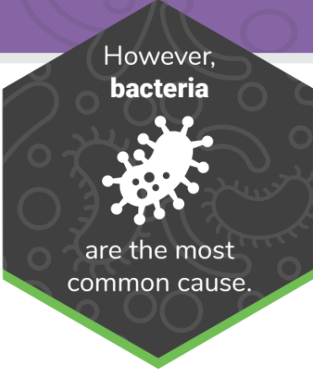
Common Organisms causing Infections in Long-Term Care Settings
MRSA
C. Difficile
Vancomycin resistant Enterococcus
Notes:
Sepsis Alliance. Long Term Care. Retrieved from https://www.sepsis.org/sepsisand/sepsis-long-term-care/
National Institutes of Health Sepsis Infographic. Centers for Disease Control & Prevention. National Center for Emerging and Zoontic Infectious Diseases. Division of Health Quality Promotion, accessed September 2019

Slide 59
Prompt Identification of Infections can Interrupt the Pathway to Sepsis.

Slide 60
Sepsis in the Nursing Home Setting
Identification
Management vs Treatment of Sepsis (NH vs Hospital Approach)
Training of Personnel who Interact with Residents (nurses, CNA’s/Med Techs, cleaning staff, maintenance staff, dining staff)
Roles of Family Members (Caregivers – what to look out for; also family that visits the NH)

Slide 61
Management/Treatment of Sepsis in Long-term Care Settings
Some initial treatment of Sepsis in NH settings can be done IF
Access to Laboratory Facilities that can provide results within a few hours
Standing Sepsis Orders for appropriate medications/tests
Ability to provide fluid resuscitation
Ability to monitor vitals at least hourly for patients at risk for sepsis who need monitoring
System for alerting Nursing and Medical Staff when Signs of Sepsis are identified
Clear Protocols and Timelines for Action
Ability to systematically record signs and symptoms, clinical interventions, and the response of the resident to those interventions.
Notes:
Jump, R. L., Levy, S. M., & Saltsman, W. S. (2019). Post-acute and long-term care settings as first responders for the surviving sepsis campaign. Journal of the American Medical Directors Association, 20(3), 275-278. doi:10.1016/j.jamda.2018.11.010

Slide 62
Sepsis Kit Content
Durable Medical Equipment: Automated Digital BP, Pulse oximeter, Thermometer
Supplies: Supplemental Oxygen, IV Catheter Kits, Blood Drawing Equipment, Urinary Catheter Kits to Monitor Output; PPE, Sterile Crystalloid Fluid, Gloves, Dressing Supplies
Lab Supplies: Blood Culture bottles (aerobic and anaerobic); sterile containers for urine, sputum, stool; bacterial culture swabs
Antibiotics: Both Oral and Intravenous
Notes:
Jump, R. L., Levy, S. M., & Saltsman, W. S. (2019). Post-acute and long-term care settings as first responders for the surviving sepsis campaign. Journal of the American Medical Directors Association, 20(3), 275-278. doi:10.1016/j.jamda.2018.11.010

Slide 63
One Hour Bundle
Measure lactate level
Remeasure lactate is initial level is > 2 mm/L
Obtain 2 blood cultures prior to administration of antibiotics
Begin rapid (bolus) administration of 30 ml/kg of crystalloid for hypotension or lactate > 4 mm/L
Apply vasopressors if patient is hypotensive during or after fluid resuscitation to maintain a MAP > than or equal to 65 mm Hg
One hour is measured from first time of notation in chart of indication of sepsis
Notes:
Society of Critical Care Medicine and the European Society of Intensive Care Medicine. Bundle. SurvivingSepsis.org/Bundle https://www.sccm.org/Clinical-Resources/Guidelines/Guidelines/Surviving-Sepsis-Campaign-Guidelines
Levy, Crit Care Med. June 2018, 46(6):997-1000.

Slide 64
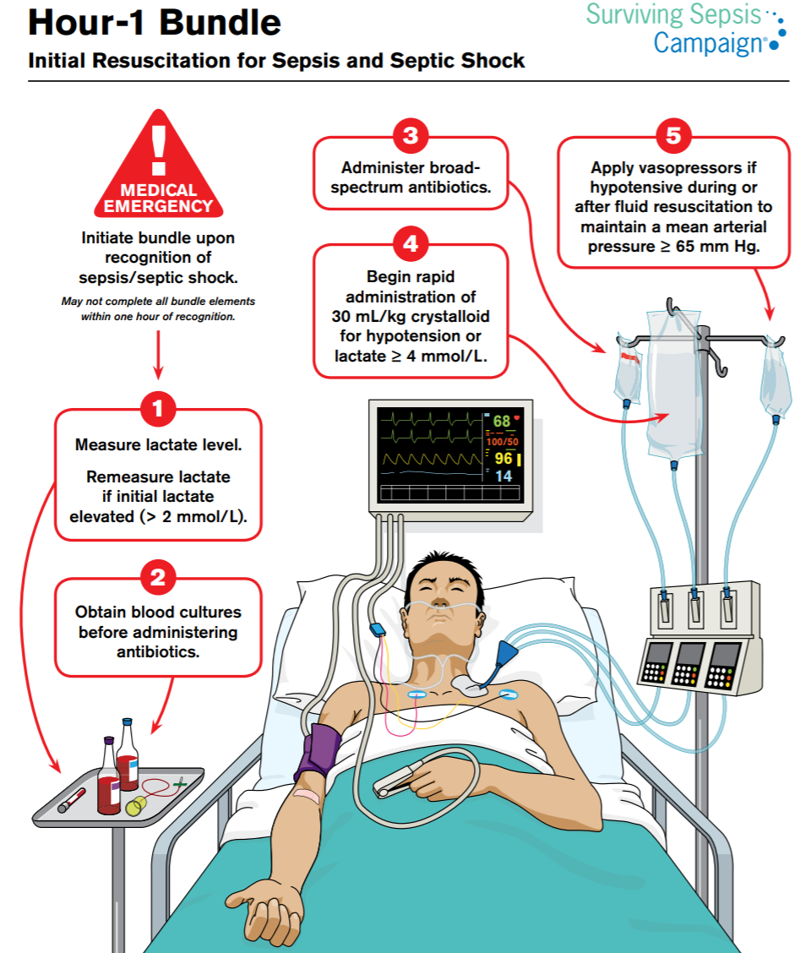
Hour Bundle
Notes:
Society of Critical Care Medicine and the European Society of Intensive Care Medicine. Bundle. SurvivingSepsis.org/Bundle https://www.sccm.org/Clinical-Resources/Guidelines/Guidelines/Surviving-Sepsis-Campaign-Guidelines

Slide 65
Three Hour Bundle
Requires broad spectrum antibiotics to be administered within first 3 hours of care for septic patients
Criteria: Suspected source of clinical infection
2 or more manifestations of systemic infection (SIRS)
Presence of sepsis induced organ dysfunction including a lactate greater than 2
Notes:
Pulia, M.S., Redwood, R., & Sharp, B., (2017). Antimicrobial Stewardship in the Management of Sepsis. Emerg Med Clin N Amer, 35: 199-217.

Slide 66
Concerns about over prescribing antibiotics may interfere with prompt administration when sepsis is suspected
Antibiotic Use Can Lead to Adverse Reactions and Allergic Reactions
The use of multiple drugs in older people is associated with an increased risk of adverse drug events
C. Difficile infections are associated with antibiotic use
Risk of infection, morbidity
Some evidence that sepsis is associated with antibiotic use
Notes:
Baggs et al. Clin Inf Dis. (2018). 66 (7), 1004-1012.
Tamura et al. Clin Ger Med (2012). 28, (2):217-236.

Slide 67
ANTIBIOTIC RESISTANCE RESULTING FROM USE OF ANTIMICROBIALS
C. Difficile
Methicillin Resistant Staphylococcus Aureus (MRSA)
Vancomycin resistant Enterococcus
Estimated more than 2 million illnesses annually from antibiotic resistance
Estimated more than 23,000 deaths annually from antibiotic resistance
C. Difficile infections affecting 500,000 patients annually
C. Difficile infections causing 15,000 annual deaths
Notes:
Pulia, M.S., Redwood, R., & Sharp, B., (2017). Antimicrobial Stewardship in the Management of Sepsis. Emerg Med Clin N Amer, 35: 199-217.

Slide 68
CLOSTRIDIUM DIFFICILE RISK AND SEPSIS ANTIBIOTIC ADMINISTRATION
CMS Core Sepsis Core Measures (Sep 1) mandates early antibiotic administration
Infectious Diseases Society of American refused to endorse 2016 recommendations because of concern over excessive antibiotic administration and it’s associated risks including C. Difficile
In this NY hospital center C. Difficile infections decreased after implementation of a sepsis protocol
This decrease resulted even though overall use of antibiotics increased after the protocol was implemented
Notes:
LeFave, J., Levy, D., Gekle, R., et al. (2019). Incidence of Clostridium Difficile Infection After Sepsis Protocol. Western Journal of Emergency Medicine: Integrating Emergency Care with Population Health, 20(6); 977-981.

Slide 69
CDC Framework for Antibiotic Stewardship
GOAL: Optimize the treatment of infections while reducing the adverse events associated with antibiotic use.
The right antibiotic
At the Right dose
At the Right Time
Notes:
Centers for Disease Control and Prevention. The Core Elements of Antibiotic Stewardship for Nursing Homes. http://www.cdc.gov/longtermcare/prevention/antibiotic-stewardship.html

Slide 70
ANTIMICROBIAL STEWARDSHIP IN MANAGEMENT OF SEPSIS
GOAL: Optimize the treatment of infection while reducing the adverse events associated with antibiotic use.
Four D’s: drug, dose, de-escalation and duration
For sepsis the right antimicrobial is broad spectrum coverage of all likely pathogens
De-escalation can occur after identification of a likely pathogen
This usually occurs days later.
Notes:
Pulia, M.S., Redwood, R., & Sharp, B., (2017). Antimicrobial Stewardship in the Management of Sepsis. Emerg Med Clin N Amer, 35: 199-217.

Slide 71
Notes:
Kumar et. Al. (2006). Duration of Hypotension before initiation of effective antimicrobial therapy. Crit Care Med. 34 (6): 1589-1596.

Slide 72
Sepsis Training Day 1
MARCH 17 2021
If Transfer to an Acute Care Facility is needed

Slide 73
Training
All staff who interact with Residents must be enlisted in identifying signs and symptoms of sepsis.

Slide 74
Family Members & Caregivers
Family Members and Caregivers can be trained in early signs and symptoms and can augment staff monitoring.

Slide 75
SEPSIS PNEMONIC FOR FAMILY MEMBERS
S = Slurred Speech/ or Confusion
E = Extreme Pain in Joints
P = Passing little urine
S = Severe breathlessness
I = “It feels like I am going to die”
S = Skin that’s mottle, pale or discolored
Notes:
Global Sepsis Alliance. Sepsis and Covid-19. https://www.global-sepsis-alliance.org/covid19. (Accessed March 11, 2021).

Slide 76
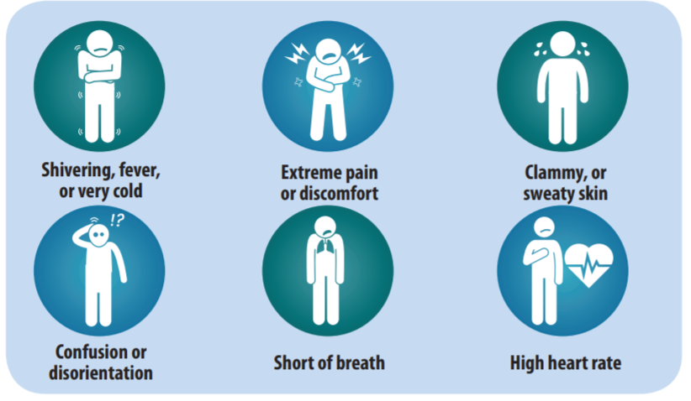
Signs & Symptoms of Sepsis
Notes:
CDC, Sepsis Alliance® and the Rory Staunton Foundation for Sepsis Prevention Fact Sheet

Slide 77
If you have identified a change while caring for or observing a resident, please circle the change and notify a nurse.
STOP and WATCH early warning tool
Either give the nurse a copy of this tool or review it with her/him as soon as you can.

Slide 78
CDC, Sepsis Alliance® and the Rory Staunton Foundation for Sepsis Prevention Fact Sheet
Long-term Effects of Sepsis
Many people who have sepsis recover completely and their lives return to normal.
Some people may experience permanent organ damage.
In someone who already has kidney problems, sepsis can lead to kidney failure that requires lifelong dialysis.
Long term cognitive deficits are not uncommon
Rehospitalization for another infection is common
Notes:
CDC, Sepsis Alliance® and the Rory Staunton Foundation for Sepsis Prevention Fact Sheet

Slide 79
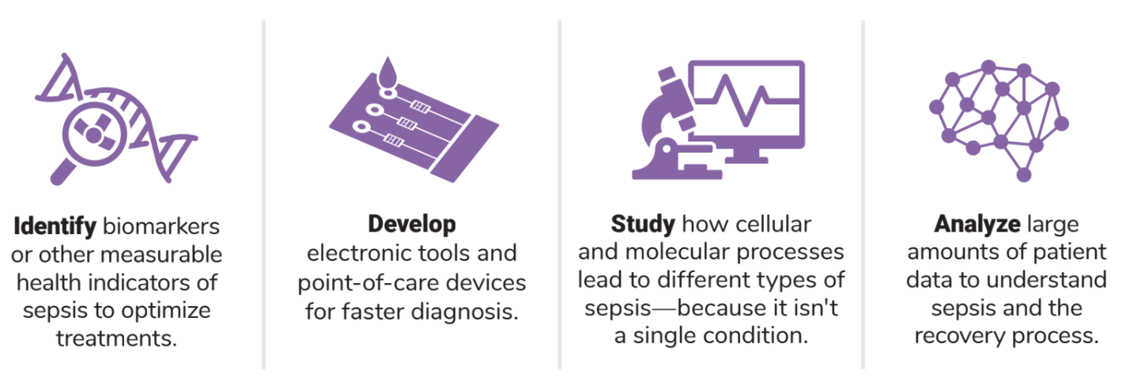
NIH Sepsis Infographic. Centers for Disease Control & Prevention. National Center for Emerging and Zoonotic Infectious Diseases. Division of Health Quality Promotion, accessed September 2019
Q: What is the future of Sepsis research?
NIH Sepsis Infographic. Centers for Disease Control & Prevention. National Center for Emerging and Zoonotic Infectious Diseases. Division of Health Quality Promotion, accessed September 2019
Notes:
National Institutes of Health Sepsis Infographic. Centers for Disease Control & Prevention. National Center for Emerging and Zoonotic Infectious Diseases. Division of Health Quality Promotion, accessed September 2019

Slide 80
Sepsis Training Day 1
MARCH 17 , 2021
Questions

